Slide 1
CHAPTER 6
Frequency Response, Bode Plots, and Resonance

Slide 2
6.1 Fourier Analysis, Filters, and Transfer Functions
大部分蘊藏資訊的訊號都不是單純的sinusoidal signals 。
但是我們可以藉由將不同大小(amplitude)、頻率(frequency)與相位(phase)的sinusoidal signals 加(adding)在一起而獲得與這些訊號一模一樣的訊號 。
我們可以藉由結合不同sinusoids 成份 (component)來組成(construct)所有訊號。

Slide 3
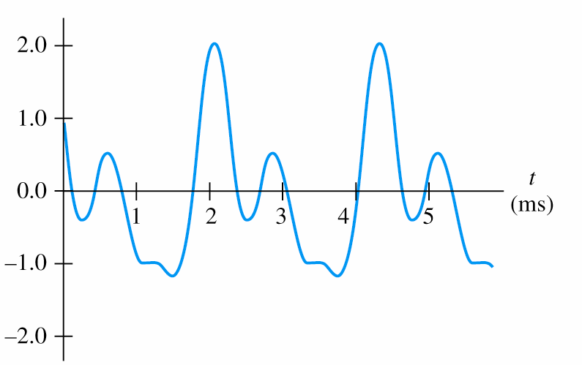
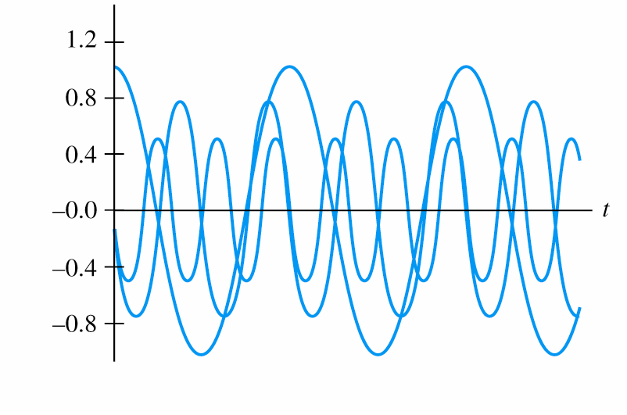
一小段music waveform
三個不同大小、頻率與相位的sinusoidal 成份(component)相加可獲得上面的 music waveform

Slide 4
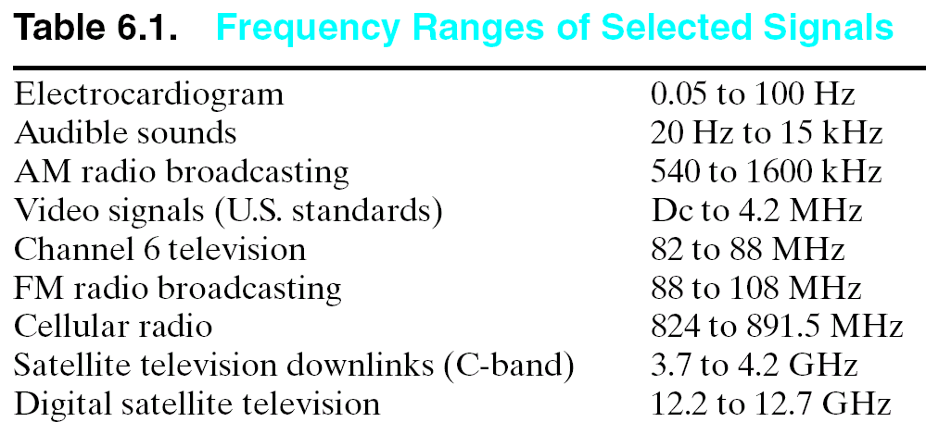
Fourier Analysis (傅利葉分析)
All real-world signals are sums of sinusoidal components having various frequencies, amplitudes, and phases.

Slide 5
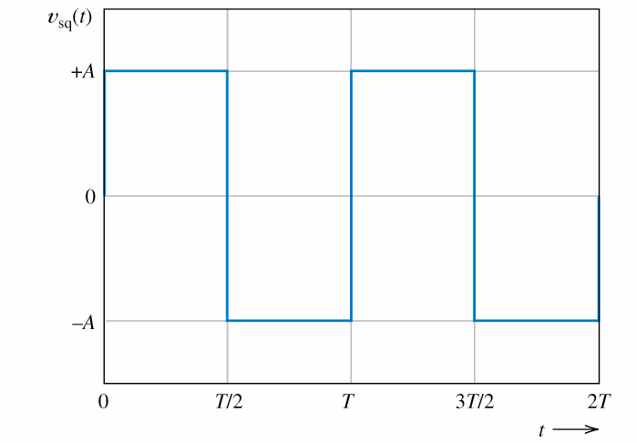
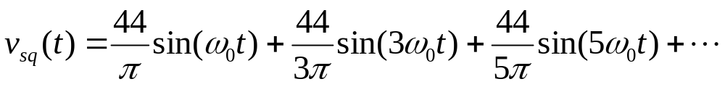

Fourier Series (傅利葉序列) of a Square Wave
方波(square wave) V_{sq}(t) 可由以下之sinusoids 來組成
稱為fundamental angular frequency (基本角頻率).

Slide 6
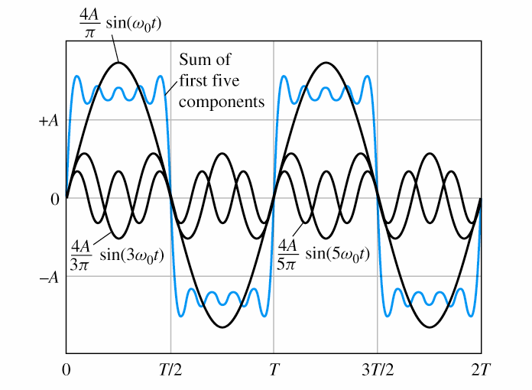


更多 Components 相加可更近似方波
方波為奇數倍基本角頻率( )的sinusoidal components 組成。
component角頻率越高時，其amplitude(大小) 越小。
所有component 相位都是-90º ( ) 。

Slide 7
Filters (濾波器)
Filters process the sinusoid components of an input signal differently depending on the frequency of each component.
(濾波器對輸入訊號之不同頻率成份進行不同處理)
Often, the goal of the filter is to retain (維持)the components in certain frequency ranges and to reject (去除)components in other ranges. (ex 收音機頻道、音響等化器、生理量測測儀,…)

Slide 8
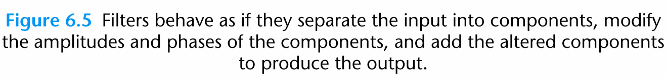
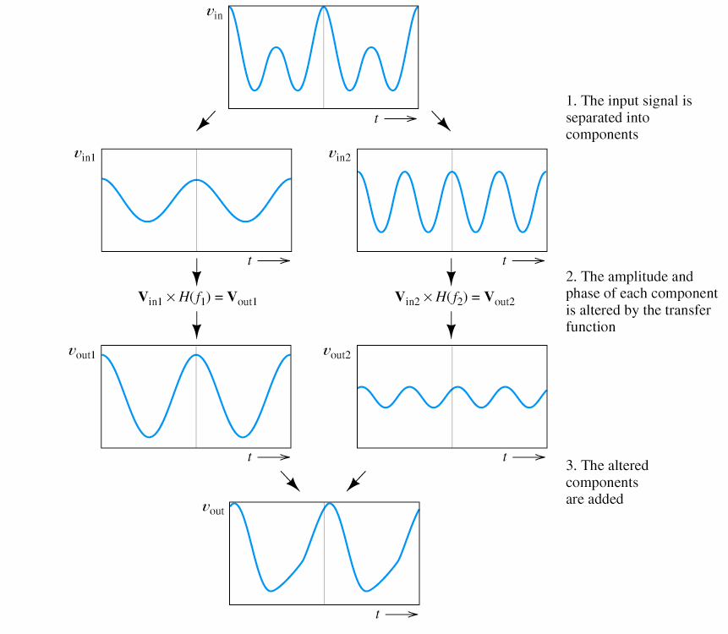

Slide 9
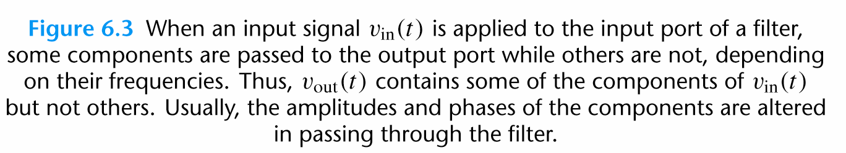
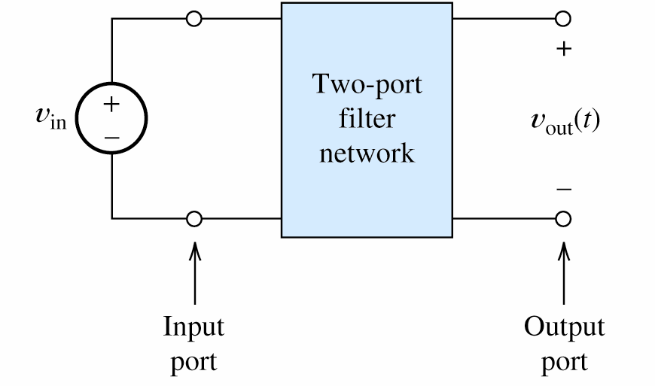
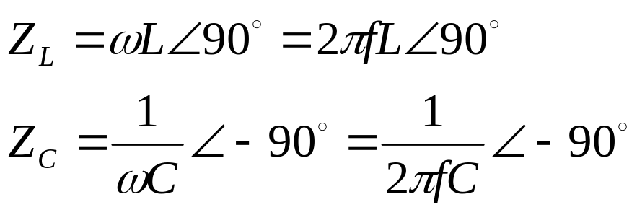
一般而言雜訊在高頻，因此低通率波器用來消除雜訊。Ex, 可藉由LC impedance 隨頻率改變的特性藉由RLC來實現慮波器。

Slide 10
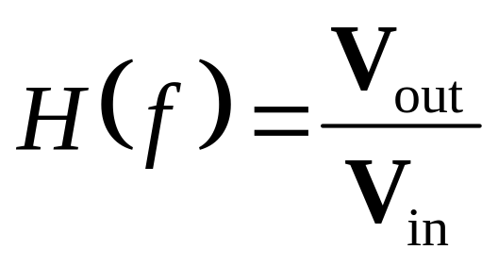
Transfer Functions (轉換函數)
The transfer function H(f ) of the two-port filter is defined to be the ratio (比值) of the phasor output voltage to the phasor input voltage as a function of frequency:
Transfer functions 是一個複數，包含 magnitude 與phase且magnitude 與phase也都是頻率的函數(function of frequency)。

Slide 11
The magnitude of the transfer function shows how the amplitude of each frequency component is affected by the filter.
Similarly, the phase of the transfer function shows how the phase of each
frequency component is affected by the filter.

Slide 12
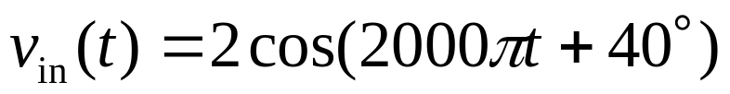
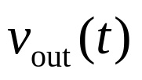
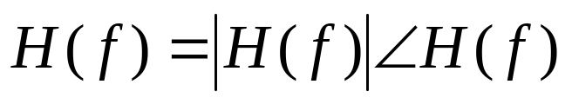
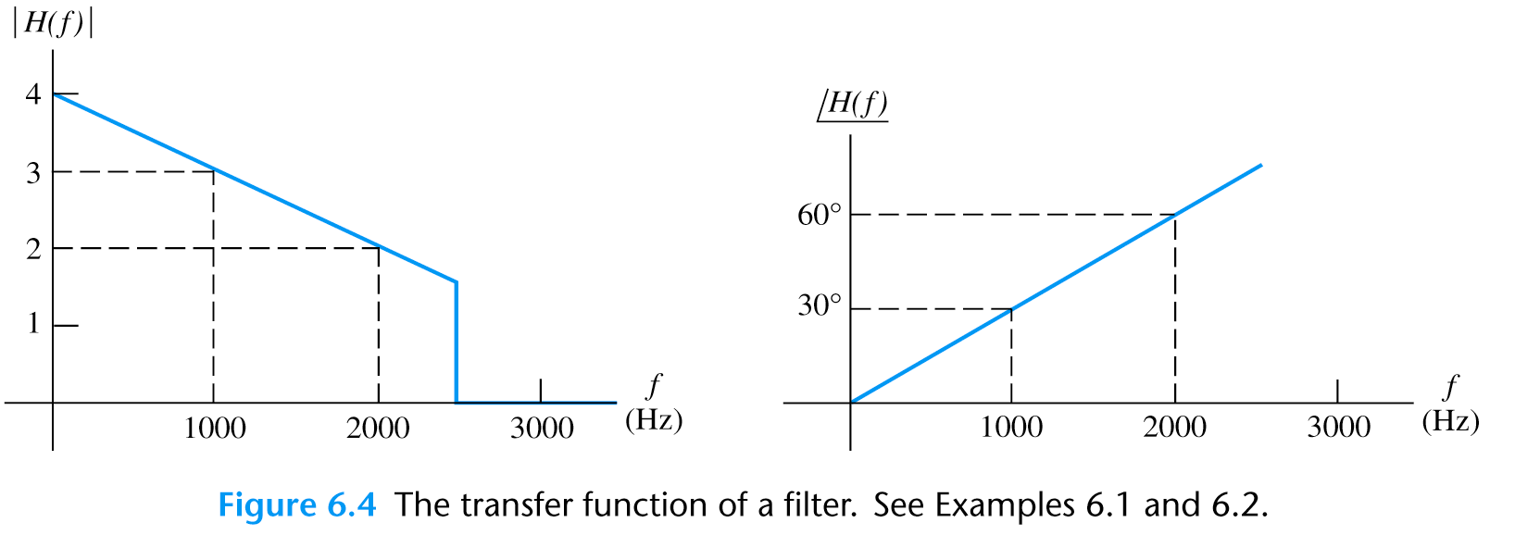
Example 6.1 Using the Transfer Function to Determine the Output.
Input
Find the output of the filter ( ) .

Slide 13
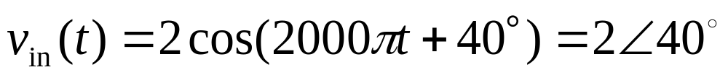
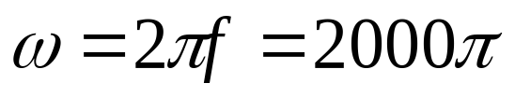
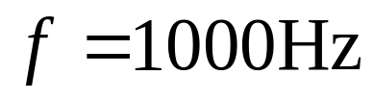
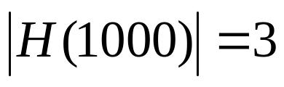
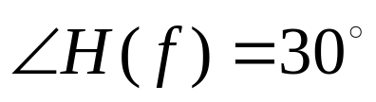
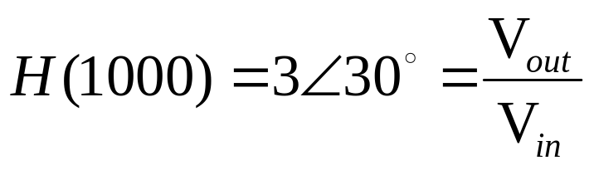
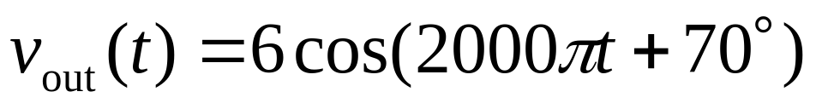

Slide 14
Determining the output of a filter for an input with multiple components:
1. Determine the frequency and phasor representation for each input component.
2. Determine the (complex) value of the transfer function for each component.

Slide 15
3. Obtain the phasor for each output component by multiplying the phasor for each input component by the corresponding transfer-function value.
4. Convert the phasors for the output components into time functions of various frequencies. Add these time functions to produce the output.

Slide 16
Example 6.2 Using the Transfer Function with Several Input Components
Find v_{out}(t).

Slide 17
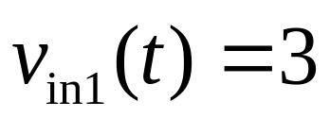
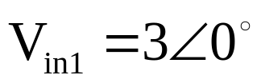

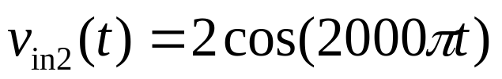
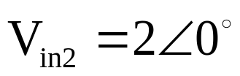

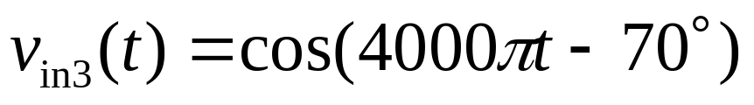
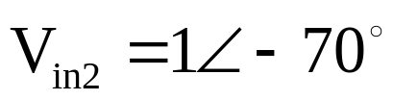
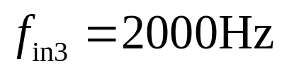
1. Determine the frequency and phasorfor each input component.

Slide 18
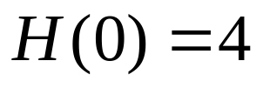


2. Determine the (complex) value of the transfer function for each component.

Slide 19
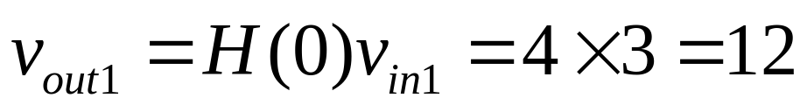
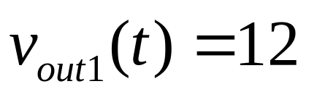
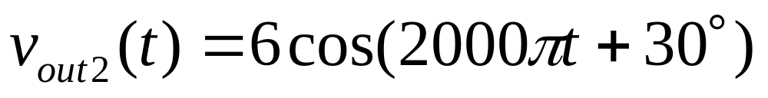
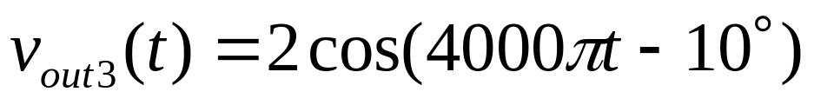
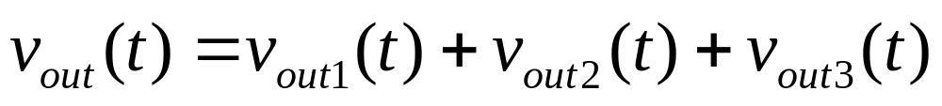
3. Obtain the phasor for each output component
4. Convert the phasors into time functions of various frequencies. Add these time functions to produce the output.

Slide 20
Linear circuits
Separate the input signal into components having various frequencies.
2. Alter (改變) the amplitude and phase of each component depending on its frequency.
3. Add the altered components to produce the output signal.

Slide 22
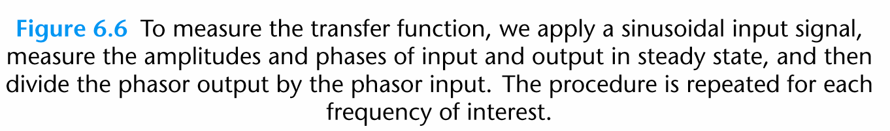
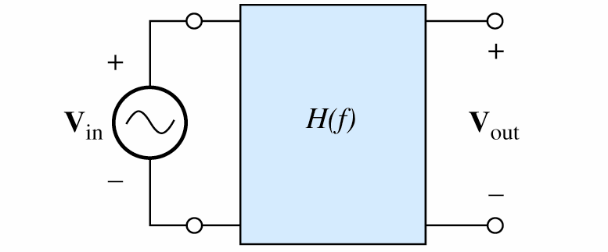

Slide 23
6.2 FIRST-ORDER LOWPASS
FILTERS (一階低通濾波器)
We can determine the transfer functions of RLC circuits by using steady-state analysis with complex impedances as a function of frequency
(可利用steady-state 分析並將阻抗表示為頻率函數的複數阻抗以決定RLC的轉換函數)

Slide 24
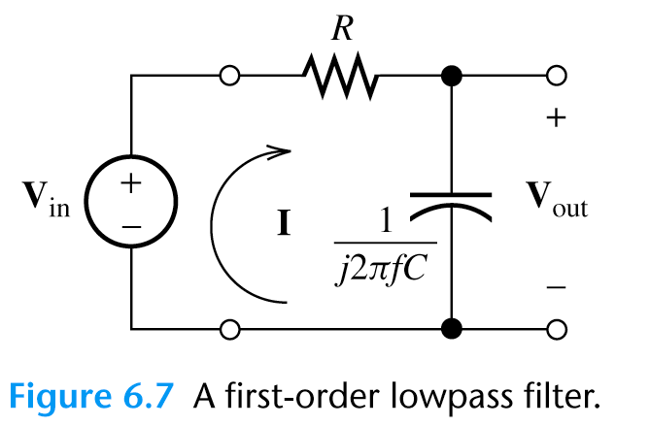
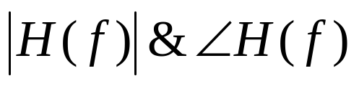
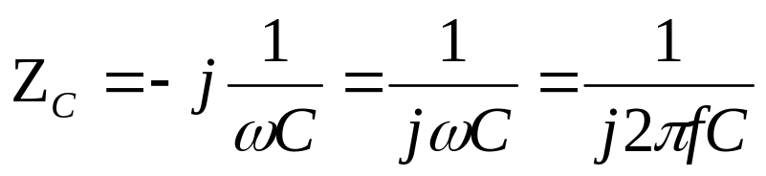
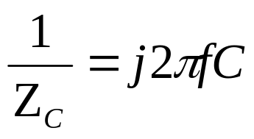
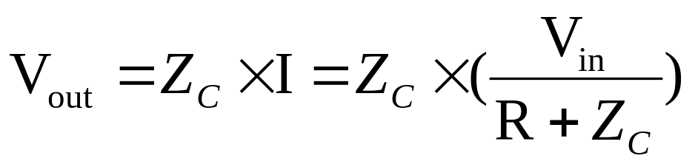
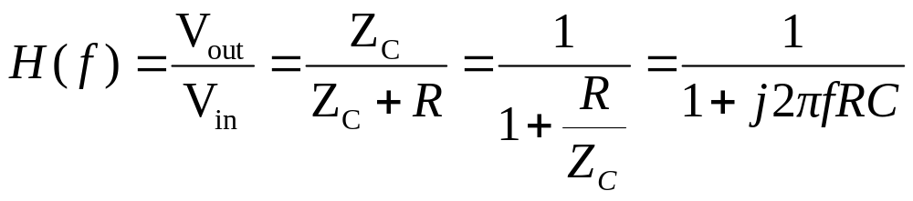
決定 , 並隨frequency 改變畫出

Slide 25
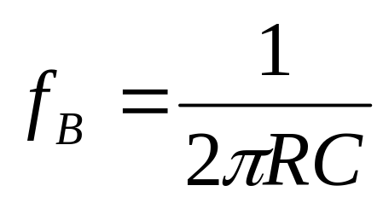
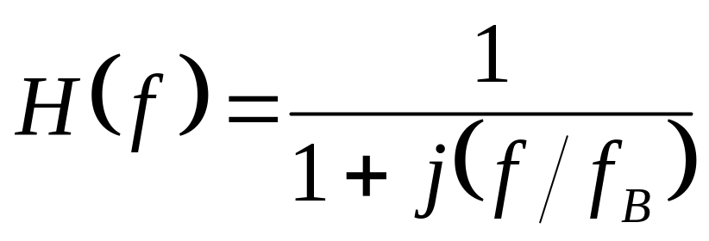
定義
Q: 如何隨frequency 改變畫出 ?

Slide 26
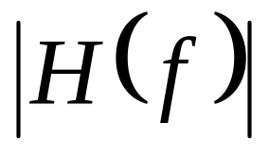
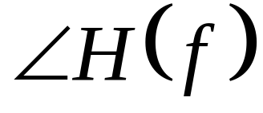
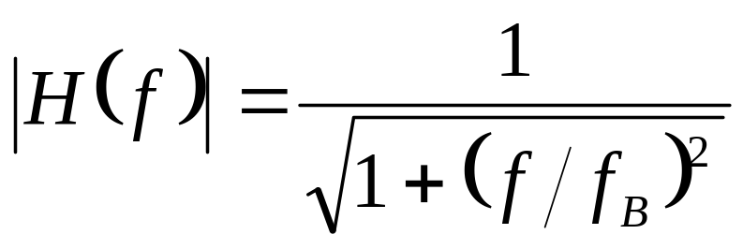
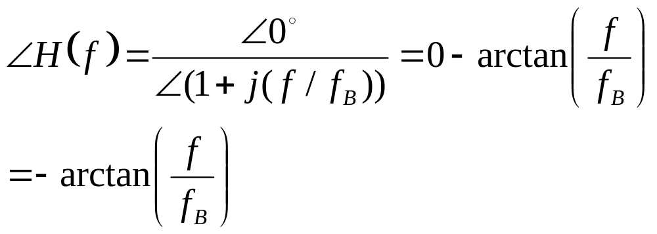
Magnitude and Phase Plots

Slide 27







Magnitude and Phase Plots
1. For low frequency
2. For high frequency

Slide 28






Magnitude and Phase Plots
3. For
稱為 half-power frequency

Slide 29

Example 6.3 Calculation of RC Lowpass Output
The RC lowpass filter is shown in Figure 6.9.
Find v_{out}(t).

Slide 30















Example 6.3 Calculation of RC Lowpass Output
1. The input components
2. The transfer function

Slide 31


3. The output components
Note: We do not add the phasors for components with different frequencies

Slide 32




6.3 DECIBELS, THE CASCADE CONNECTION, AND LOGARITHMIC FREQUENCY SCALES
Decibel (dB) 分貝

Slide 33



Why using dB?
Very small and very large magnitudes can be displayed clearly on a single plot.
Linear scale
但圖上看不出大小
dB scale
可清楚看出
Notch filter:消除某些頻率component, 60Hz in this case.

Slide 34


THE CASCADE CONNECTION (串接)
In cascade connection, the output of one filter is connected to the input of a second filter
(前級filter的輸出是後級filter 的輸入)
H(f)

Slide 35





THE CASCADE CONNECTION (串接)
In dBs, the individual transfer-function magnitudes are added to find the overall transfer-function magnitude

Slide 36

Logarithmic Frequency Scales
On a logarithmic scale, the variable is multiplied by a given factor for equal
increments of length along the axis.
The advantage of a logarithmic frequency scale compared with linear scale is that the variations of a transfer function for a low range of frequency and the variations in a high range can be shown on a single plot.
×10
×2

Slide 37


A decade is a range of frequencies for which the ratio of the highest frequency to the lowest is 10.
An octave is a two-to-one change in frequency.

Slide 38

6.4 BODE PLOTS
A Bode plot shows the magnitude of a network function in decibels versus frequency using a logarithmic scale for frequency.

Slide 39





A Bode plot of the first-order lowpass transfer function (先R後C)

Slide 40



A Bode plot of the first-order lowpass transfer function- Magnitude plot
1. For low frequency
低頻漸近線(low-frequency asymptote)為水平直線
2. For high frequency
高頻漸近線(high-frequency asymptote)為斜率 -20dB/decade之直線, 起始於f=f_{B}, 故f_{B}稱為corner frequency or break frequency.

Slide 41


3. For
頻率每增加10倍
Magnitude減少20dB

Slide 42

A Bode plot of the first-order lowpass transfer function- Phase plot
A horizontal line at zero for f < (f_{B} /10).
2. A sloping line from 0 phase at f_{B} /10 to –90° at 10f_{B}.
3. A horizontal line at –90° for f > 10f_{B}.

Slide 43



Exercise 6.11 Sketch approximate straight-line Bode magnitude and phase plots
A 先R後C circuit
Lowpass filter

Slide 44


The magnitude plot is approximated by
0 dB below 1000 Hz
A straight line sloping downward at 20 dB/decade above 1000 Hz.
The phase plot is approximated by
0ºbelow 100 Hz
-90º above 10 kHz
a line sloping downward between 0º at 100 Hz and -90º at 10 kHz.

Slide 45



Applications of Electronics and Circuits
Human Computer Interface-Flex Sensor
手攤平(手指彎曲度最小)
手握拳(手指彎曲度最大)

Slide 46


Applications of Electronics and Circuits
Human Computer Interface-Flex Sensor
Low Pass Filter

Slide 47





6.5 FIRST-ORDER HIGHPASS FILTERS (先C後R)

Slide 48






Magnitude and Phase Plots
1. For low frequency
2. For high frequency

Slide 49


Magnitude and Phase Plots
3. For

Slide 50



A Bode plot of the first-order highpass transfer function- Magnitude plot
1. For low frequency
低頻漸近線(low-frequency asymptote)為斜率 +20dB/decade之直線
2. For high frequency

Slide 51


3. For

Slide 52

A Bode plot of the first-order highpass transfer function- Phase plot
與lowpass filter 類似, 只是加了90º.

Slide 53



Example 6.4 Determine the break frequency of a highpass filter
Determine the break frequency of a first-order highpass filter such that the transfer-function magnitude at 60 Hz is -30 dB.
When

Slide 54
Appendix-Fourier Series of a Square Wave
方波(square wave) V_{sq}(t) 可由以下之sinusoids 來組成

Slide 55
% Matlab Code
T = 1; % Period = 1s
t=0:0.01:3*T; % t=0-3s, delta t=0.1s
Omega0 = 2*pi/T; % Omega0=2*pi*f=2*pi
Vsq_3=[zeros(1,length(t))]; % vector for the sum of the first 3 terms
Vsq_9 =[zeros(1,length(t))]; % vector for the sum of the first 9 terms
for i=1:3
Vsq_3=Vsq_3+(44/((2*i-1)*pi))*sin(Omega0*(2*i-1)*t);
end
for i=1:9
Vsq_9=Vsq_9+(44/((2*i-1)*pi))*sin(Omega0*(2*i-1)*t);
end
subplot(2,1,1)
plot(t, Vsq_3);
xlabel('Time (sec)');
ylabel('Vsq3');
subplot(2,1,2)
plot(t, Vsq_9);
xlabel('Time (sec)');
ylabel('Vsq9');

Slide 56


